Slide 1
Racism in Healthcare Toolkits

Slide 2
Racism in Healthcare Toolkits

Slide 3
Misconduct, Missing, and Murdered: Experiences of Anti-Indigenous Racism in Reproductive Healthcare Amongst Indigenous Women, Girls, Two-Spirit, Transgender, and Gender-Diverse People and the MMIWG2S+ Genocide”
ANTI-INDIGENOUS RACISM TOOLKIT FOR HEALTH AND SOCIAL CARE PROVIDERS
A significant factor in the Missing and Murdered Indigenous Women, Girls, Two-Spirit, Transgender, and Gender-Diverse People (MMIWG2S+) genocide is the anti-Indigenous racism that Indigenous Women, Girls, Two-Spirit, Transgender, and Gender-Diverse (WG2STGD) people experience at an alarmingly high rate, particularly as it pertains to reproductive healthcare. Through decades of advocacy and research, The Native Women’s Association of Canada (NWAC) has listened to the knowledge, perspectives, and experiences of Indigenous WG2STGD people regarding health and social care providers (HSCPs), many of whom shared painful and violent experiences of anti-Indigenous racism.
This toolkit enables HSCPs to implement the National Inquiry’s Calls to Justice 3.2 and 7.6 and redress the ongoing MMIWG2S+ genocide. This toolkit also furthers NWAC’s Our Calls Our Action Plan to provide lasting health, policy, research, training, and programs to support Indigenous-led health initiatives, including mental health and wellness and ending forced sterilization.

Slide 4
Your first interaction with new patients or clients starts before they enter your office or virtual appointment. To help facilitate a safe and welcoming environment and improve patient or client rapport, these are a few things you can do to improve the safety of your space:
Include preferred pronouns on your staff’s nametags
Ask for pronouns to be included in patient/client charts
Research the correct land acknowledgement for your area and add a visible sign in the office entry and a small footer on all print materials and electronic communications. Avoid leading visits with alcohol and substance-use-related questions
Avoid stigmatizing language
Avoid unnecessary questions about health that are not related to the patient’s visit

Slide 5
WHO IS THIS TOOLKIT FOR?
This toolkit provides direct and curated support to HSCPs in their daily practices, including health care providers, social care professionals, and other professionals.
As a health and social care provider, you play an important role in the safety of Indigenous People who seek your services. It can be an intimidating, re-traumatizing, and frustrating experience for Indigenous People, particularly Indigenous WG2STGD people, to discuss their health and social care needs with professionals. Due to complex trauma and other factors that some Indigenous WG2STGD people live with, particularly surrounding medical care, they may have difficulty communicating their needs. A written survey post-visit can provide a safe approach to providing valuable feedback.
It is difficult for HSCPs to know the number of Indigenous patients/clients they serve; however, to better your practice and provide the best care possible, it is vital to know the population you are assisting. There are only advantages to pursuing personal and professional growth by implementing different approaches to healthcare. Ensuring trauma-informed care is beneficial to all patients and clients and can promote your practice or clinic as a safe space for Indigenous People seeking healthcare.

Slide 6
THE BENEFITS OF USING THIS SURVEY TOOL
As you may already be aware, there is limited training and educational support provided to HSCPs regarding Indigenous Peoples’ history and your current role in minimizing the ongoing violence from past and ongoing colonialization. Or this might be your first exposure to this kind of information. It’s okay that you might be just starting to learn it now- this toolkit can be your first step!
Some offices do not collect ethnic information about their patients/clients, and you may not know the actual number of Indigenous People you serve. Even if you suspect there might not be many Indigenous People in your practice, providers like you can contribute to a better understanding of the Indigenous clients you serve or if factors are hindering them from being honest in their care. You can use this survey by sending it out to each person, and those that specify that they are Indigenous will be able to continue through the entire questionnaire. This survey can be a valuable way to gain insight into your patient/client population and requires minimal effort.
The Post-Visit Survey for Indigenous Patients and Clients (Appendix A) can improve the quality of care your patients or clients receive at your practice without adding to your already full schedule. Having the questionnaire available to your patients or clients in survey form means that you can enhance the comprehensiveness of your EMRs or other medical records.

Slide 7
Taking the time to understand your patients’ experiences now can save you time in the future; if they do not feel comfortable sharing something now, it may become a more significant issue later.
Professional improvement is an integral aspect of health and social care, which can be one way to identify ways to improve your practice quickly.
It is an easy way to make your patients feel like their opinion is valued and that your office is a place they are cared about.
Spearheading initiatives such as this can be daunting, but it demonstrates leadership and offers the possibility to facilitate discussion with other providers.
The benefit of this being a written survey administered post-visit is that the individual can complete it after they leave the appointment on their own time, as it is often easier for some patients to express their opinions without direct confrontation. This survey shows your patients and clients that you care about providing the best care possible!

Slide 8
HOW TO USE THIS TOOLKIT
The toolkit seeks to provide a foundation for HSCPs to provide trauma-informed, culturally relevant, gender-based, distinctions-based, and intersectional healthcare. This means doing everything possible to promote the safety, consent, and well-being of all Indigenous Peoples. Ensuring consent and safety means providing a space for confidentiality and anonymity, especially regarding the survey results you collect. The data collected using this tool is sensitive and must be kept anonymous and confidential. The responses must not affect the patient or client’s future access to services. It is unethical, unempathetic, illegal, and unkind to use patients’ information against them. NWAC is not responsible for HSCPs’ use of the survey; instead, we provide this survey as a tool and option to engage in better practices. NWAC encourages you to draft and include a privacy statement explaining to survey takers who can access their survey responses how it will be used and for how long it will be kept.
The “Post-Visit Survey for Indigenous Patients and Clients” was designed to be quick and easy to complete for your patient or client and simple to implement in various health and social care settings. Your practice may already utilize electronic surveys for the patient or client care; in this case, adding the survey questions to your automation platform will be easy. This survey can seamlessly integrate with your existing visit communications after a visit or interaction. The questionnaire can be included in your post-visit electronic communications along with the next appointment information or next treatment steps. Suppose you do not already use electronic questionnaires for every visit. In that case, you can send the survey in email or paper format with a “dropbox” available for submitting the completed response (similar to that of a comments or suggestions box).

Slide 9
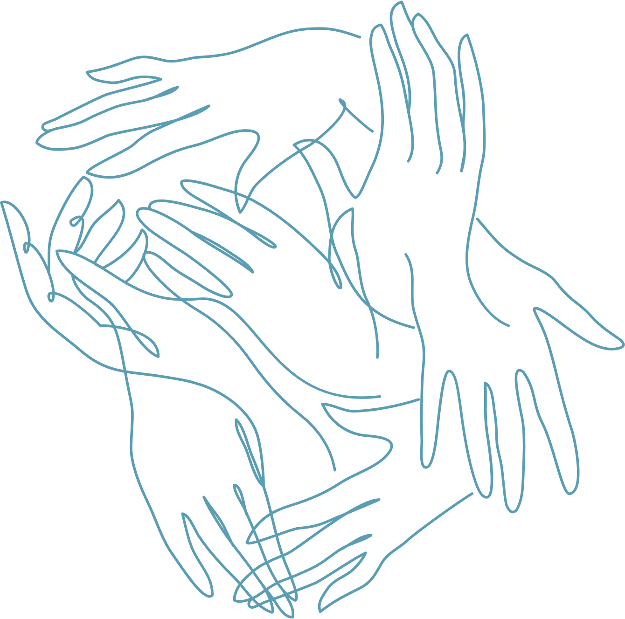
To accompany the “Post-Visit Survey for Indigenous Patients and Clients,” we have created a short presentation that you can use to obtain a background in these topics and provide context. We envision the role of the clinic administrator or lead medical officer to present the slide show and discuss ways to improve the quality of care received by your Indigenous patients and clients before implementing the survey in daily practice.
Please use the NWAC educational slideshow (Appendix B) for more tips on providing culturally safe, trauma-informed and affirming care.

Slide 10
MORE EDUCATION RESOURCES AND TRAINING PROGRAMS FOR HSCPS:
NWAC’s Culturally Relevant, Gender-Based Analysis Starter Kit
NWAC’s Trauma-Informed Response to Sexual and Reproductive Health
Indigenous Health Resources Hub by the University of Toronto
Learn about the benefits of Cannabis
Take NWAC’s Restoring the Circle Training about TRAUMA-INFORMED APPROACHES TO SERVICE PROVISION
See BC’s Cultural Safety and Humility Standard
Joyce’s Principle
Notes:
https://stbbi.nwac.ca/wp-content/uploads/2021/02/CRGBA-Starter-Kit.pdf
https://stbbi.nwac.ca/wp-content/uploads/2021/02/Trauma-informed-Care-Fact-Sheet.pdf
https://bloomberg.nursing.utoronto.ca/current-students/academic-resources/indigenous-health-resources/
https://nwaccannabised.ca/
https://restoringthecirclenwac.ca/#/
https://thetyee.ca/News/2022/12/08/New-Tool-To-End-Racism-Against-Indigenous-Patients/ ⁷ https://principedejoyce.com/sn_uploads/principe/Joyce_s_Principle_brief___Eng.pdf
https://thetyee.ca/News/2022/12/08/New-Tool-To-End-Racism-Against-Indigenous-Patients/ ⁷ https://principedejoyce.com/sn_uploads/principe/Joyce_s_Principle_brief___Eng.pdf

Slide 11
RESOURCES TO PROVIDE TO INDIGENOUS PATIENTS:
NWAC’s Know Your Rights for Reproductive and Sexual Healthcare
NWAC’S Culturally Safe Parent and Caregiver Starter Kit
NWAC’s Culturally Safe and Trauma-Informed Knowledge Hub
Notes:
https://nwac.ca/assets-knowledge-centre/KnowingYourRights-Booklet-EN-Web-_1.pdf
https://nwac.ca/assets-knowledge-centre/31-March-STBBI_Toolki-EN.pdf
https://stbbi.nwac.ca/trauma-informed-care-resources/

Slide 12
MMIWG2S+ GENOCIDE
What does MMIWG2S+ stand for?
Missing and Murdered Indigenous Women, Girls, Two-Spirit, Transgender, and Gender-Diverse People
What does that mean for Indigenous Peoples?
75% of survivors of sexual assault in Indigenous Communities are young
Women under 18 years of age
In one Ontario study, researchers found that 73% of gender-diverse and Two- Spirit Indigenous people experienced some form of violence, with 43% having experienced physical and/or sexual violence
Indigenous Women make up 1.2% of Ontario’s population but 6% of female homicide victims; 88% were mothers
Indigenous Women and Girls are more likely to be killed by a stranger compared to non-Indigenous women
Two-Spirit youth experience strong links between self-harm and intergenerational trauma and are often shamed due to Western norms.

Slide 13
WHY IS THIS IMPORTANT?
As a health care and social care professional, you have committed to providing compassionate, trauma-informed care
Indigenous Peoples have the right to health and proper healthcare
While one person cannot solve the entire problem, a collective that is willing to work towards better can make improvements
Small changes could be the difference between a patient seeking care or not
Those effected by MMIWG2S+ deserve providers that care about their health outcome equity that accounts for their lived experiences, need for trauma-informed care, and wellbeing as Indigenous Peoples
Cries for improvement and change have never resulted in better health outcomes
Calls to Justice 15.1-15.8 asks Canadians to learn how violence against Indigenous women and girls is part of longstanding colonial policies, rather than a result of individual choice

Slide 14
MMIWG2S+ AND HEALTHCARE
Indigenous People who are pregnant can experience rates of poorer mental health while pregnant, with lasting effects on themselves and their children
Services for those who have experienced violence are rarely provided with the services and care needed to foster healing
Poor healthcare to those who are survivors of MMIWG2S+ can result in additional trauma, healthcare issues, and mental health concerns

Slide 15
AIR AND HEALTHCARE
Setter-colonial violence is seen in interpersonal forms of violence in the healthcare system. This can manifest as:
Lack trauma-informed care
Does not take the time to ask relevant questions
Does not take the time to examine the patient assuming the issue is related to alcohol use, addiction, or sexual deviance
Assumes all Indigenous Peoples are the same and have the same healthcare needs
This results in poorer health outcomes for Indigenous Peoples including:
Negligent care that leads to death
Long term healthcare concerns going unaddressed
Lack of trust towards HSCP by Indigenous People
Higher rates of Type 2 diabetes, heart disease, and high cholesterol
Malnutrition

Slide 16
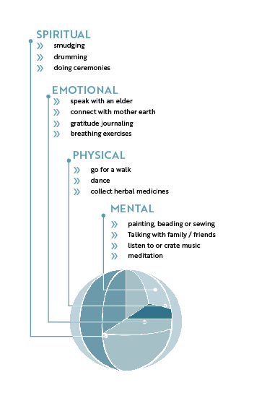
INTEGRATING INDIGENOUS METHODS
Indigenous methods and medicine are not contrary to biomedicine, but complimentary
Holistic and collaborative approaches to healthcare provide extensive benefits to Indigenous Patients. Be mindful of the diversity of Indigenous Peoples, as not all use the medicine wheel or other tools in their wellbeing.
This is one way to provide Indigenous Patients/Clients with an environment where they may feel safer to seek care.
Regardless of scientific validation, integrating holistic methods of wellbeing serves to provide unseen benefits on an emotional, mental, and spiritual forms of health needed for all.
These methods may also benefit other non-Indigenous patients/clients.
^{Indigenous Self-care}
Build balanced self-care routine with the suggestions below

Slide 17
TIPS AND TRICKS FOR BEST PRACTICES
Never assume the needs or circumstances of Indigenous Patients/Clients
Increasing sensitivity to a patient’s/client’s needs will benefit all patients/clients AND the provider
Listen to what Indigenous Patients/Clients tell you they need – to be heard is Important
Ask if the patient/client would like to incorporate any non-Western or Traditional forms of medicine
Be patient: Indigenous patients may be skeptical of the healthcare system (understandably so)
Use a patient/client survey to capture experiences
Ask relevant questions, but understand that you may not know what a trigger may be
Remember: not all Indigenous Communities are the same
To access the National Call to Action Plan or NWAC’s Safe Passage Website for more information and resources

Slide 19
POST -VISIT FEEDBACK SURVEY FOR INDIGENOUS PATIENTS AND CLIENTS
“The survey answers you provide will be used for the sole purpose of helping [service provider] adapt the way [I/we] respond to and honour your [clients/patients/service users] unique needs. [I/we] [am/are] gathering this information for the specific purpose of improving the way [I/we] deliver [health/social] services to you. Your survey answers, including sensitive and private information, will only be viewed by [service provider and/or service provider’s staff]. [I/We] will not disclose your information to anyone else, except where compelled to by law. You can change your mind and withdraw your consent at any time by informing [me/us] in writing or verbally, without giving a reason. Do you consent to [service provider] receiving your survey answers? Click [yes/no].”
Are you completing this survey on behalf of yourself or for a minor who sought these services?
For myself
For my child or a dependent
How did you communicate during your appointment?
Telephone
In-Person
Virtual video call- over the internet
Date of your visit or appointment: MM/DD/YY

Slide 20
In thinking about your overall experience with your service provider and their office, answer the following questions based on your level of satisfaction:
1
Did the staff use language that you were able to understand?
1
2
3
4
5
Dissatisfied
Somewhat dissatisfied
Neutral
Somewhat Satisfied
Extremely Satisfied
Was anything said to you that made you feel uncomfortable?
Yes
No
Unsure

Slide 21
2
Did a staff member, health care, or social care professional:
Comment on your appearance in a way that made you feel uncomfortable? (This can mean your clothing, jewellery, makeup, etc).
Yes
No
Unsure
Was anything said to you that made you feel uncomfortable?
Yes
No
Unsure
Made an inappropriate comment on your body.
Yes
No
Unsure
Made an inappropriate comment on the way that you spoke or your behaviour.
Yes
No
Unsure

Slide 22
2
Did a staff member, health care, or social care professional:
Asked an inappropriate question that was not related to why you
Yes
No
Unsure
If you answered “Yes” to any or wish to comment on another experience, please elaborate:

Slide 23
3
Did you feel safe in this space as an Indigenous Person?
1
2
3
4
5
Dissatisfied
Somewhat dissatisfied
Neutral
Somewhat Satisfied
Extremely Satisfied
Did you feel uncomfortable in the environment because there was no one else who looked visibly Indigenous or like you?
1
2
3
4
5
Dissatisfied
Somewhat dissatisfied
Neutral
Somewhat Satisfied
Extremely Satisfied
Did you feel uncomfortable because of past bad experiences in a similar setting?
1
2
3
4
5
Dissatisfied
Somewhat dissatisfied
Neutral
Somewhat Satisfied
Extremely Satisfied

Slide 24
3
Did you feel safe in this space as an Indigenous Person?
Did you feel uncomfortable because you heard about others who had bad experiences here?
1
2
3
4
5
Dissatisfied
Somewhat dissatisfied
Neutral
Somewhat Satisfied
Extremely Satisfied
Please elaborate here:

Slide 25
4
In thinking about the staff and care, please answer the following questions:
Do you feel your lived experience as an Indigenous Person is valued and respected by staff?
1
2
3
4
5
Dissatisfied
Somewhat dissatisfied
Neutral
Somewhat Satisfied
Extremely Satisfied
Do you feel that your service provider is open to including Traditional Knowledge and Medicine in the discussion about your treatment?
1
2
3
4
5
Dissatisfied
Somewhat dissatisfied
Neutral
Somewhat Satisfied
Extremely Satisfied
If they are open to including Traditional Knowledge and Medicine, did your service provider give you options that embrace Traditional Teaching and Knowledge?
1
2
3
4
5
Dissatisfied
Somewhat dissatisfied
Neutral
Somewhat Satisfied
Extremely Satisfied

Slide 26
4
In thinking about the staff and care, please answer the following questions:
Do you feel that your individual health and wellbeing needs as an Indigenous person are being met by this service provider and their staff/team?
1
2
3
4
5
Dissatisfied
Somewhat dissatisfied
Neutral
Somewhat Satisfied
Extremely Satisfied
Do you feel that the staff acknowledges and provides care according to your unique needs which could be affected by your past experiences as an Indigenous Person due to ongoing colonization, Missing and Murdered Indigenous Women and Girls (MMIWG2S+), Residential Schools and the 60s Scoop?
1
2
3
4
5
Dissatisfied
Somewhat dissatisfied
Neutral
Somewhat Satisfied
Extremely Satisfied

Slide 27
5
How can the staff improve their care for Indigenous Patients?
This office should include more specific information about issues affecting Indigenous People in their brochures/signage/newsletters etc.
1
2
3
4
5
Dissatisfied
Somewhat dissatisfied
Neutral
Somewhat Satisfied
Extremely Satisfied
The service provider should improve their understanding of Traditional Knowledge and Medicine
1
2
3
4
5
Dissatisfied
Somewhat dissatisfied
Neutral
Somewhat Satisfied
Extremely Satisfied
The staff and/or service provider should be more knowledgeable of the issues affecting Indigenous Peoples
1
2
3
4
5
Dissatisfied
Somewhat dissatisfied
Neutral
Somewhat Satisfied
Extremely Satisfied

Slide 28
5
How can the staff improve their care for Indigenous Patients?
Please elaborate here:

Slide 29
6
What did you like most about your experience today?
Did you feel safe and heard by your provider and their staff?
1
2
3
4
5
Dissatisfied
Somewhat dissatisfied
Neutral
Somewhat Satisfied
Extremely Satisfied
Did you feel like you could communicate your needs?
1
2
3
4
5
Dissatisfied
Somewhat dissatisfied
Neutral
Somewhat Satisfied
Extremely Satisfied
Did you feel like that your service provider had a good discussion with you about your treatment/health?
1
2
3
4
5
Dissatisfied
Somewhat dissatisfied
Neutral
Somewhat Satisfied
Extremely Satisfied

Slide 30
6
What did you like most about your experience today?
Did you enjoy your interactions with the office staff?
1
2
3
4
5
Dissatisfied
Somewhat dissatisfied
Neutral
Somewhat Satisfied
Extremely Satisfied
Would you recommend a friend or family member use this office for services?
1
2
3
4
5
Dissatisfied
Somewhat dissatisfied
Neutral
Somewhat Satisfied
Extremely Satisfied
Please elaborate here:

Slide 31
APPENDIX
Appendix A: Post-Visit Survey for Indigenous Patients and Clients (Medical and Allied health)
Appendix B: NWAC Educational Slideshow
Introduction to Implementing Culturally Safe and Affirming Care for Your Indigenous Patients and Clients for Health and Social Care Providers
This toolkit was created as part of a larger project, “Funding Proposal to Commission Five Policy Research Papers on Missing and Murdered Indigenous Women, Girls, and Two-Spirit People,” funded by Crown-Indigenous Northern Affairs Canada (CIRNAC).

Slide 32
Racism in Healthcare Toolkits
Thank you! Merci! Miigwetch!

